Slide 1

The Multi-Class Classification
Notes:
1

Slide 2
Objectives
Build a multiclass classifier for the Sign Language MNIST dataset
Learn how to properly set up the ImageDataGenerator parameters and the model definition functions for multiclass classification
The multi-class classification-discusses and examples
2

Slide 3
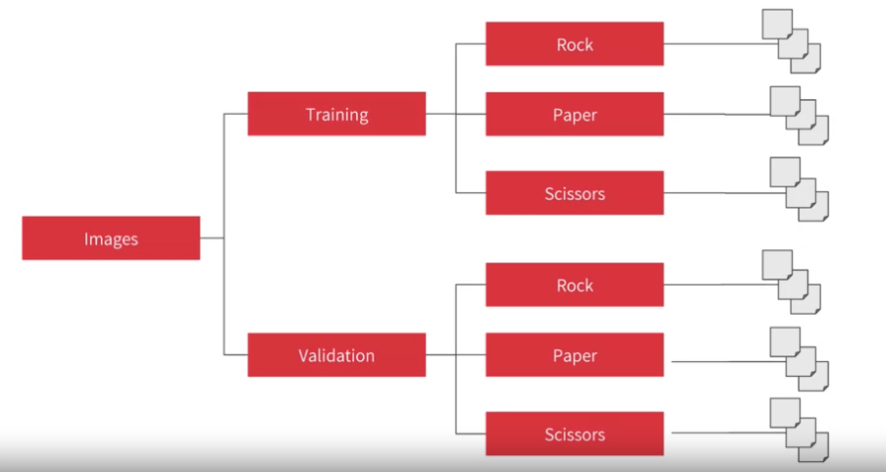
Multi-Class
File structure for multi-class
The multi-class classification-discusses and examples
3
Notes:
3

Slide 4
Rock-Paper-Scissors dataset
Rock-Paper-Scissors is a dataset containing 2,892 images of diverse hands in Rock/Paper/Scissors poses.
Rock Paper Scissors contains images from a variety of different hands, from different races, ages, and genders, posed into Rock / Paper or Scissors and labeled as such
Each image is 300×300 pixels in 24-bit color
The multi-class classification-discusses and examples
4
Notes:
4

Slide 5
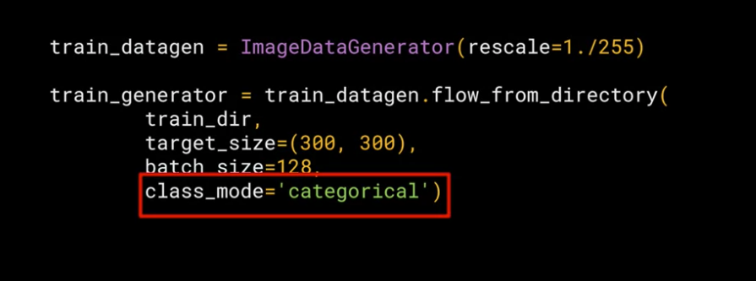
Multi-Class Classification
Set up the image generator for multi-class
The multi-class classification-discusses and examples
5
Notes:
5

Slide 6
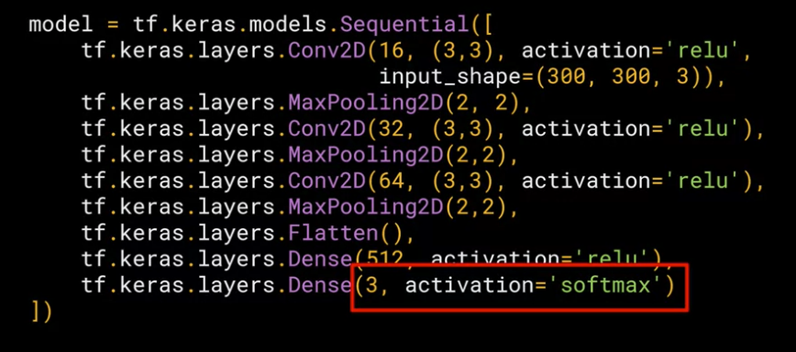
Multi-Class Classification
Define your model for multi-class
The multi-class classification-discusses and examples
6
Notes:
6

Slide 7
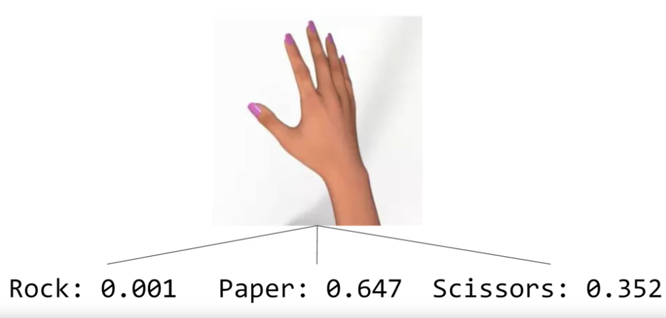
Multi-Class Classification
Discuss the image: which class the image belong ?
The multi-class classification-discusses and examples
7
Notes:
7

Slide 8
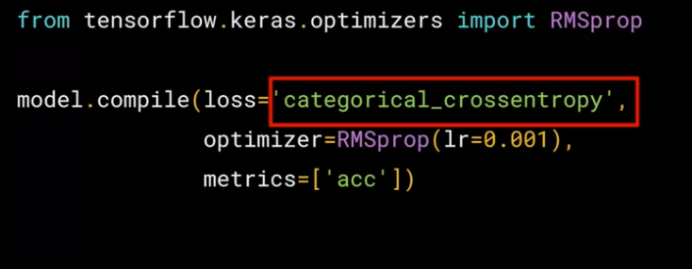
Multi-Class Classification
Compile with multi-class
The multi-class classification-discusses and examples
8
Notes:
8

Slide 9
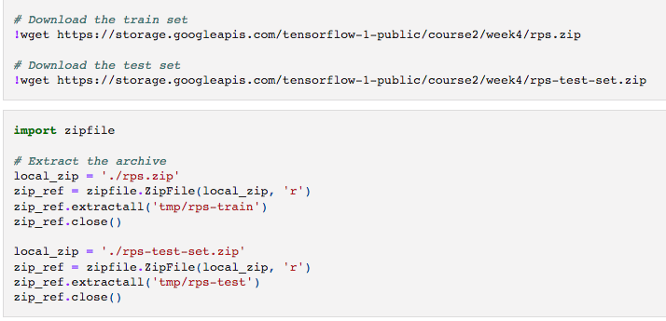
Multi-Class Classification
Download and Prepare the Dataset
The multi-class classification-discusses and examples
9
Notes:
9

Slide 10
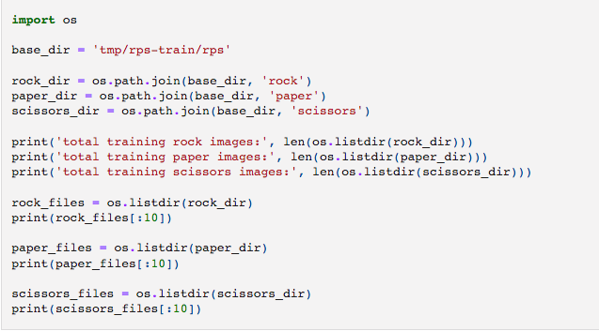
Multi-Class Classification
Assign the directory names into variables
The multi-class classification-discusses and examples
10
Notes:
10

Slide 11
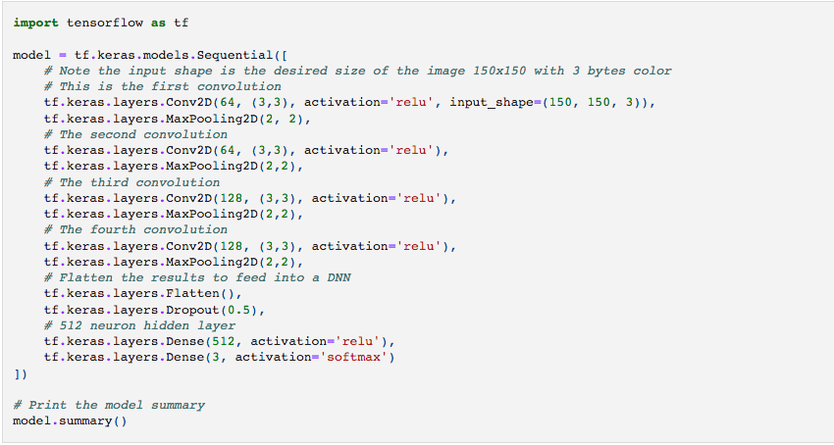
Multi-Class Classification
Build the model
The multi-class classification-discusses and examples
11
Notes:
11

Slide 12
Multi-Class Classification
Set the training parameters
The multi-class classification-discusses and examples
12
Notes:
12

Slide 13
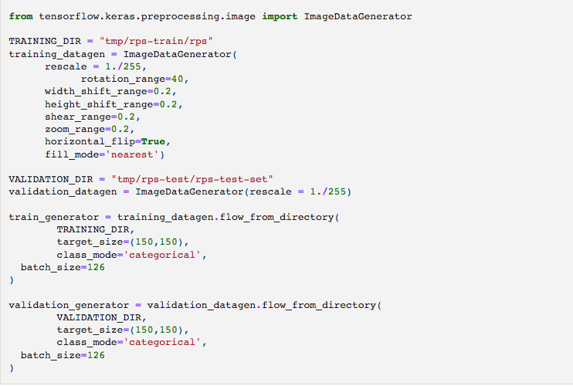
Multi-Class Classification
Prepare the ImageDataGenerator
The multi-class classification-discusses and examples
13
Notes:
13

Slide 14
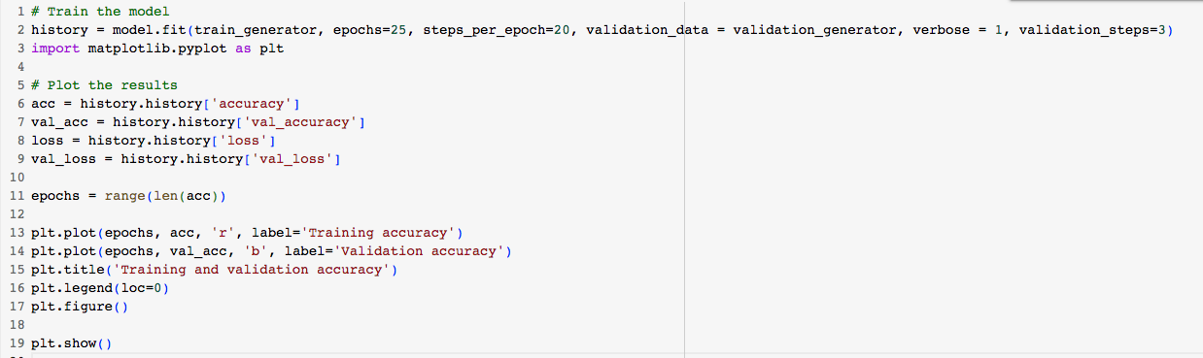
Multi-Class Classification
Train the model and evaluate the results
The multi-class classification-discusses and examples
14
Notes:
14

Slide 15
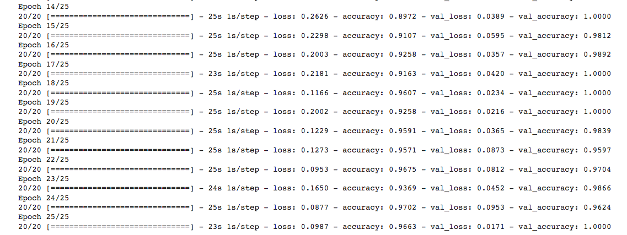
Multi-Class Classification
Train process
The multi-class classification-discusses and examples
15
Notes:
15

Slide 16
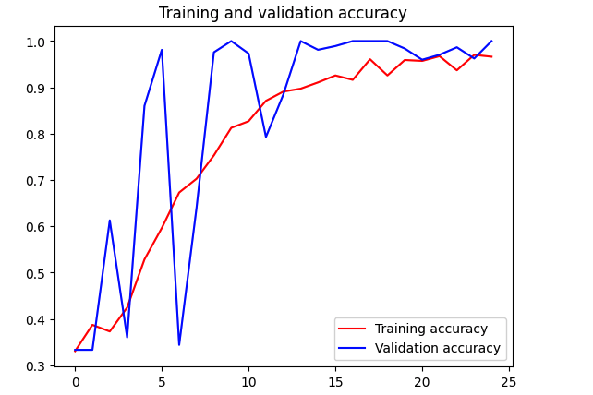


Multi-Class Classification
The multi-class classification-discusses and examples
16
Notes:
16

Slide 17
Summary
Build a multiclass classifier for the Sign Language MNIST dataset
Learn how to properly set up the ImageDataGenerator parameters and the model definition functions for multiclass classification
The multi-class classification-discusses and examples
17

Slide 18
Q & A
The multi-class classification-discusses and examples
18

